Slide 1


Data classification using machine learning.
Guided By:
Dr. Rushikesh Borse
By:
Vijay Talekar (B_13)
Piyush Patil (B_14)
Rutwik Deshmukh (B_20)
Ganesh Kelgandre (B_31)

Slide 2
What is Machine Learning?
The ability of Machine to learn by itself without knowing the explicit knowledge is called machine learning.
Machine Learning is a current application of AI based around the idea that we should really just be able to give machines access to data and let them learn for themselves

Slide 3
Types :
Supervised Machine Learning.
Unsupervised Machine Learning.

Slide 4
Supervised learning
It infers a function from labeled training data consisting of a set of training examples.
Eg : Medical diagnosis
Types of SL
1. Classification
2. Regression

Slide 5
Classification:
classify a document into a predefined category.
documents can be text, image.
Decision
Step1 : Train the program (Building a Model) using a training set with a category for e.g. sports, cricket, news
Classifier will compute probability for each word, the probability that it makes a document belong to each of considered categories
Step2 : Test with a test data set against this Model
Eg:
1. Fraud detection
2. Image classification

Slide 6
Unsupervised Machine Learning.
References are drawn from datasets consisting of input data without labeled responses.
Clustering is one of the US learning technique.
Eg :
1 :Grouping customer

Slide 7
Techniques
• classification: predict class from observations
• clustering: group observations into “meaningful” groups
• regression (prediction): predict value from observations

Slide 8
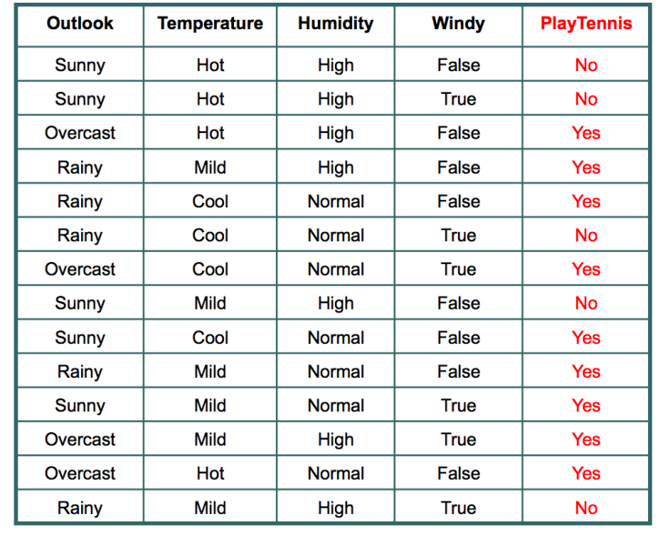
Data sets
Tennis play
Outlook | Temperature | Humidity | Windy | Play Tennis
overcast | hot | normal | true | ?
sunny | mild | High | False | ?
Rainy | cool | high | false | ?

Slide 9
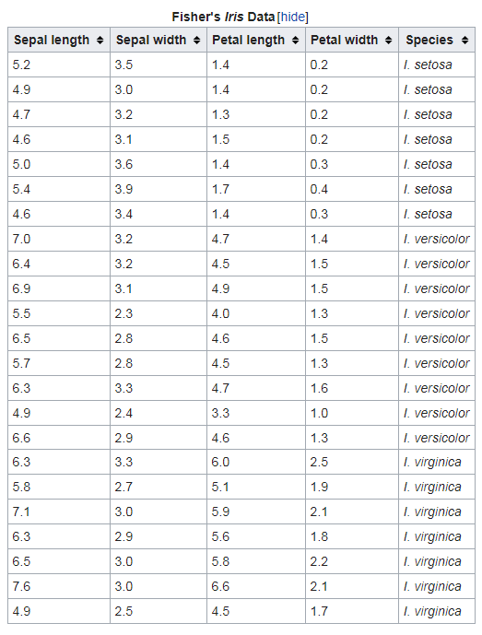
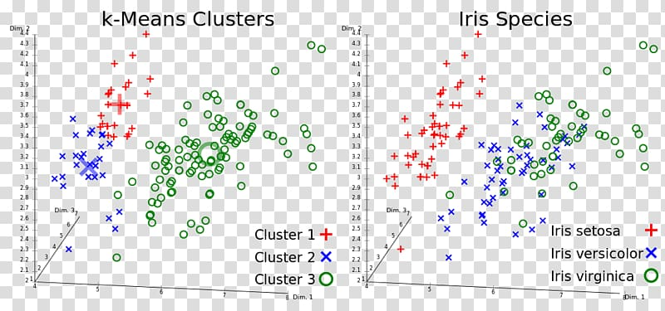
Iris flower
Sepal length | Sepal width | Petal length | Petal width | species
4.7 | 3.1 | 1.4 | 0.4 | ?
7.0 | 3.6 | 5.3 | 2.4 | ?

Slide 10
Algorithms
Decision Tree
Random Forest
K- nearest neighbour
Naïve Bayes

Slide 11
Decision Tree
A decision tree is a decision support tool that uses a tree like model of decisions and their possible consequences , including chance event outcomes.
It is type of supervised ML
Data is split continuously according to certain parameter

Slide 12
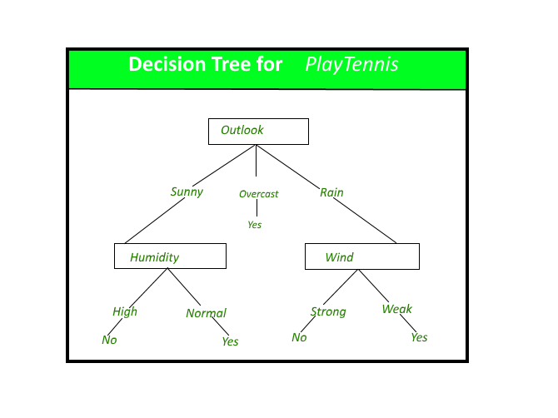
Decision Tree
A decision tree is a decision support tool that uses a tree like model of decisions and their possible consequences , including chance event outcomes.

Slide 13
Information, information Gain, Entropy
Information : facts provided or learned about something or someone.
information Gain: it indicates how much information a particular variable gives about the final outcome.
Entropy: It measure the impurity or uncertainty present in the data

Slide 14
Competative Analysis of various ML techys
Accuracy, other Confusion matrix metrics….
Time
Complexity
Etc…

Slide 15
References
Alpaydin Ethem,Book- Introduction to ML, Publisher: PHI Learning Pvt. Ltd.; Third edition (25 January 2015)
Shekhar Pandey , Supriya M, and Abhilash Shrivastava Conference Paper · January 2018 [https://www.researchgate.net/publication/320549282]
Youtube link [https://www.youtube.com/watch?v=BO4g2DRvL6U]
towardsdatascience.com

